Slide 1

A New Technology to Help Leaders Go to the Next Step in Developing Strengths
Dr. Jack Zenger – CEO of Zenger Folkman
Dr. Joseph Folkman – President of Zenger Folkman

Slide 2

Better Leaders, Better Results

Slide 3
Leaders with Better Skills Consistently Deliver Better Results

Slide 4
Managers’ Behavior is Contagious
Higher performing managers had direct reports with higher performance
Poor performing managers had direct reports with lower performance
Results based on 265 leaders
© 2016 Zenger | Folkman. All Rights Reserved.

Slide 5

Our Goal 25 Years Ago: “Help Bad Leaders become Good Leaders”
Our first efforts to help leaders improve was primarily focused on helping bad leaders to no longer be bad; hopefully for some to become good leaders.
We believed the major problem to overcome was their weaknesses. Identifying significant weaknesses was the key to improvement.

Slide 6

Original Process
Assess each leader
Identify their weaknesses
Create plan to improve those weaknesses
Assumption—A leader's weaknesses hold them back from being a good leader.

Slide 7

After 25 years we discovered a better way

Slide 8
Impact of Leadership Effectiveness with No Perceived Strengths
Number of Profound Strengths (Competencies at the 90th percentile)

Slide 9
Impact of One Strength on Overall Perception of Leadership Effectiveness
Number of Profound Strengths (Competencies at the 90th percentile)

Slide 10
Three Strengths Raises Leadership Effectiveness to the 81st Percentile
Number of Profound Strengths (Competencies at the 90th percentile)

Slide 11

You don’t have to be perfect to be an extraordinary leader

Slide 12

New Assumption
It is not the absence of weaknesses that make leaders extraordinary but rather the presence of strengths.

Slide 13
Are all the approaches to strengths the same?
Using Natural Strengths to Succeed
Building Strengths
Assumptions
People are born with or acquire at a young age a few capabilities.
If a person can identify those capabilities and use them in their everyday life, they will be more successful.
Assumptions
Everyone is attracted to or prefers some activities over others. These our passions and interests.
Often when you are passionate or interested in something you become better at that activity.
Passions and organizational needs can change over time.
Through practice and using the right approach strengths can be built.

Slide 14

This discovery raised a new question
Are the methods used to build strengths the same as those used to fix weaknesses?

Slide 15
Linear Development
How do you build a strength? Current approach to development plans.
Desired
Future
Performance
Current
Performance
More
Better
Faster
Smarter
Colleagues question level of technical expertise
Colleagues confident of technical expertise

Slide 16





Linear versus Non-linear Development
If Technical Expertise was a Significant Weakness
If Technical Expertise is a strength
Take a
Class
Take
More
Classes
Technical
Expertise
Read a
Book
Read
More
Books
Subscribe to
A Journal
Subscribe to
More
Journals
Notes:
As Joe is talking about ways of inspiring…maybe global pictures to illustrate the words instead of the using the words…not sure perky is global?

Slide 17

What is Linear Development?
Based on intuitive logic.
Most firms in the leadership development space have created dictionaries of linear development activities.
This approach helps people move from poor performance to acceptable performance.
But, doing the same thing (even with more vigor) and expecting radically different outcomes is basically the definition of insanity.
Our conclusion: to build a strength often requires a different approach.

Slide 18
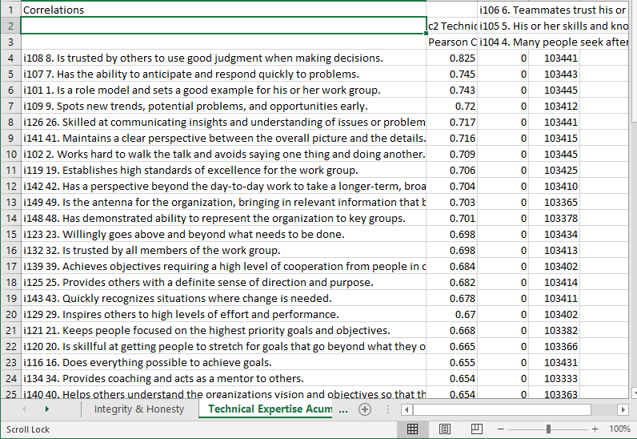
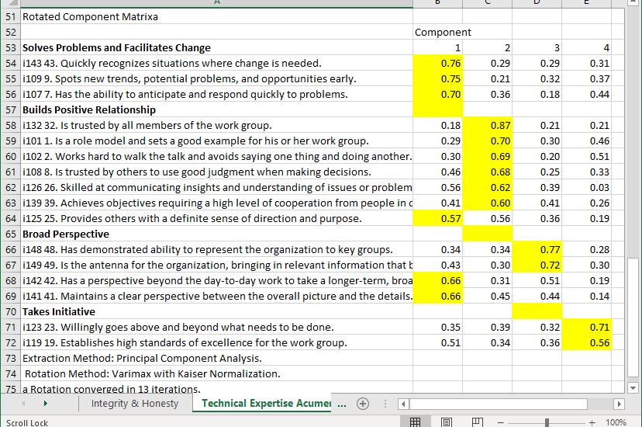
To understand what leaders did to develop strengths we analyzed our data
What did the leaders with profound strengths in a competency do that average leaders did not do?
Analyzing data from thousands of leaders led to new insights.

Slide 19
Competency Companions Provide Non-linear Insights
Solves Problems and Analyzes Issues
The Competency Companion Development Guide provides research based on thousands of leaders on how to build a profound strength.
The research examined what the best leaders did to build their competence on each of the 19 differentiating competencies.
We’ve called this process non-linear development.
Can Be
Trusted
to Act in the
Team’s Best
Interest
Relationship
Building and
Networking
Technical/
Professional
Expertise
Honesty and Integrity
Communicates Powerfully
Develops
Others
Desires to
Pursue
Excellence
Takes
Initiative

Slide 20

Non-linear Development Gives Leaders Options
Using companion behaviors provides alternative ways to build strengths.
We recommend focusing effort on just two or three companion behaviors.
Leaders can choose those behaviors that fit them and their personality.

Slide 21

How do Competency Companions Work?
The competency and the competency companion often fit together in people’s perceptual systems.

Slide 22

How do Competency Companions Work?
2. Competency companions facilitate the expression of the behaviour associated with that competency.
There is a linkage between interpersonal skills and technical skills.
What appears to happen is that strong interpersonal skills:
Facilitate the sharing of knowledge.
Persuade others to a new position.
Increase positive interactions in solving problems.

Slide 23

How do Competency Companions Work?
3. Achieving a high level of skill in one behaviour helps develop a related behaviour.
For example, one of the strongest competency companions for “developing other people” is being skilled and interested in developing yourself. If leaders do not have a well-defined, actionable career plan for themselves, it is more difficult to assist their direct reports in creating their career plans.

Slide 24

How do Competency Companions Work?
4. A competency companion is a building block or core element of the desired competency.
A strong companion behaviour to integrity is assertiveness.

Slide 25

How do Competency Companions Work?
5. Competency companions change the context in which we operate.
We found a strong relationship between a person’s ability to communicate and the extent to which a person is trusted. Typically, when people attempt to improve their ability to communicate, they focus on the message and the delivery (e.g., what they say and how they say it).
Listening better often has far more impact on being perceived as an excellent communicator.

Slide 26

How do Competency Companions Work?
6. Developing a competency companion changes the person.
Many people have had the experience of developing a new skill and then observing interesting side effects.
Learning to play golf well gives a person increased confidence.
Regular exercise makes people feel less stressed.
Accomplishing a challenging goal causes depression to go away.
Strengthening a competency has the capacity to change a person’s perspective, attitudes, and outlook on life.

Slide 27

Companion Behaviors – Is there good evidence for the theory?
Our initial research indicated that improving a companion behavior would improve an intended competency.
The only way to test this theory would be to gather pre-test and post-test results on a group of leaders.

Slide 28
Evidence that improving companion competencies causes improvement in a competency being developed
Analyzed a dataset of 882 leaders who had participated in the Extraordinary Leader assessment and had both pre- and post-test data.
157 of the leaders showed that they made a significant improvement in the competency “Inspires and Motivates Others.”
We examined data from these individuals to see if there was a link between the improvement of a competency and the improvement of the companion behaviors.

Slide 29
Research Identified 10 Companion Behaviors for Inspires and Motivates Others
Making an
Emotional
Connection
Role Model
Establishes Stretch Goals
Champions
Change
Clear Vision and Direction
Inspires
and Motivates Others
Takes Initiative
Communicates Powerfully and Prolifically
Fostering Innovation
Develops
Others
Being Collaborative and a Good Team Player

Slide 30
Analyzed Pre- versus Post-test Differences on Individual Behaviors
The 157 leaders who significantly improved their ability to Inspire and Motivate improved from the 33rd to the 73rd percentile on their effectiveness in that competency.
Each of the remaining 46 behaviors in the survey were then compared between pre- and post-test results.

Slide 31
Leaders who improved in their ability to inspire and motivate others

Slide 32
22 of the top 25 behaviors showing the largest significant differences connected to 9 of the 10 companion behaviors in the model
Top 25 behaviors
Making an
Emotional
Connection
Establishes Stretch Goals
Companion Competency | Item | Pre-test | Post-test | t-value | Sig.
Stretch Goals | Ni115 15. Creates an atmosphere of continual improvement in which self and others push to exceed the expected results. | 29.6 | 60.5 | -16.7 | 0
Collaboration | Ni137 37. Promotes a high level of cooperation between all members of the work group. | 30.7 | 60.1 | -16.3 | 0
 | Ni108 8. Is trusted by others to use good judgment when making decisions. | 33.4 | 56.9 | -15.6 | 0
Stretch Goals | Ni120 20. Is skillful at getting people to stretch for goals that go beyond what they originally thought possible. | 29.7 | 58.2 | -15.3 | 0
Develops Others | Ni135 35. Is truly concerned about developing others. | 30.2 | 58.3 | -15.2 | 0
Communicates | Ni127 27. Helps people understand how their work contributes to broader business objectives. | 30.7 | 59.7 | -15.0 | 0
Role Model | Ni101 1. Is a role model and sets a good example for his or her work group. | 32.2 | 56.8 | -15.0 | 0
Develops | Ni136 36. Gives honest feedback in a helpful way. | 30.9 | 58.6 | -14.7 | 0
Collaboration | Ni138 38. Resolves conflict within the work group. | 30.9 | 60.6 | -14.6 | 0
Role Model | Ni102 2. Works hard to walk the talk and avoids saying one thing and doing another. | 32.6 | 57.1 | -14.5 | 0
Develops Others | Ni134 34. Provides coaching and acts as a mentor to others. | 29.4 | 56.3 | -14.4 | 0
Communicates | Ni125 25. Provides others with a definite sense of direction and purpose. | 30.9 | 56.5 | -14.2 | 0
Make the Emotional Conn | Ni133 33. Stays in touch with issues and concerns of individuals in the work group. | 31.9 | 59.3 | -14.0 | 0
Communicates | Ni126 26. Skilled at communicating insights and understanding of issues or problems. | 32.2 | 57.1 | -13.9 | 0
Strategic | Ni141 41. Maintains a clear perspective between the overall picture and the details. | 33.8 | 59.9 | -13.7 | 0
 | Ni106 6. Teammates trust his or her ideas and opinions because of in-depth knowledge and experience. | 33.8 | 57.0 | -13.6 | 0
Collaboration | Ni139 39. Achieves objectives requiring a high level of cooperation from people in other parts of the organization. | 32.7 | 58.8 | -13.5 | 0
Innovation | Ni110 10. Frequently encourages others to consider new approaches and ideas (e.g., avoids getting stuck in a one right way approach). | 31.5 | 56.6 | -13.4 | 0
Make the Emotional Conn | Ni132 32. Is trusted by all members of the work group. | 33.4 | 58.0 | -13.4 | 0
Takes Initiative | Ni122 22. Can always be counted on to follow through on commitments. | 34.6 | 56.4 | -13.4 | 0
Innovation | Ni112 12. Constructively challenges the standard approaches and finds improved processes to get work done. | 31.4 | 58.5 | -13.3 | 0
Innovation | Ni111 11. Finds ways to improve new ideas rather than discourage them. | 31.3 | 58.0 | -13.3 | 0
Make the Emotional Conn | Ni131 31. Balances getting results with a concern for others needs. | 33.1 | 58.9 | -13.2 | 0
Stretch Goals | Ni119 19. Establishes high standards of excellence for the work group. | 32.3 | 55.2 | -13.1 | 0
 | Ni104 4. Many people seek after his or her opinions. | 34.1 | 56.9 | -13.1 | 0
Role Model
Champions
Change
Clear Vision and Direction
Inspires
and Motivates Others
Takes Initiative
Communicates Powerfully and Prolifically
Fostering Innovation
Develops
Others
Being Collaborative and a Good Team Player

Slide 33
Pre-Post Differences Sorted by Difference between Pre- and Post-test Results

Slide 34
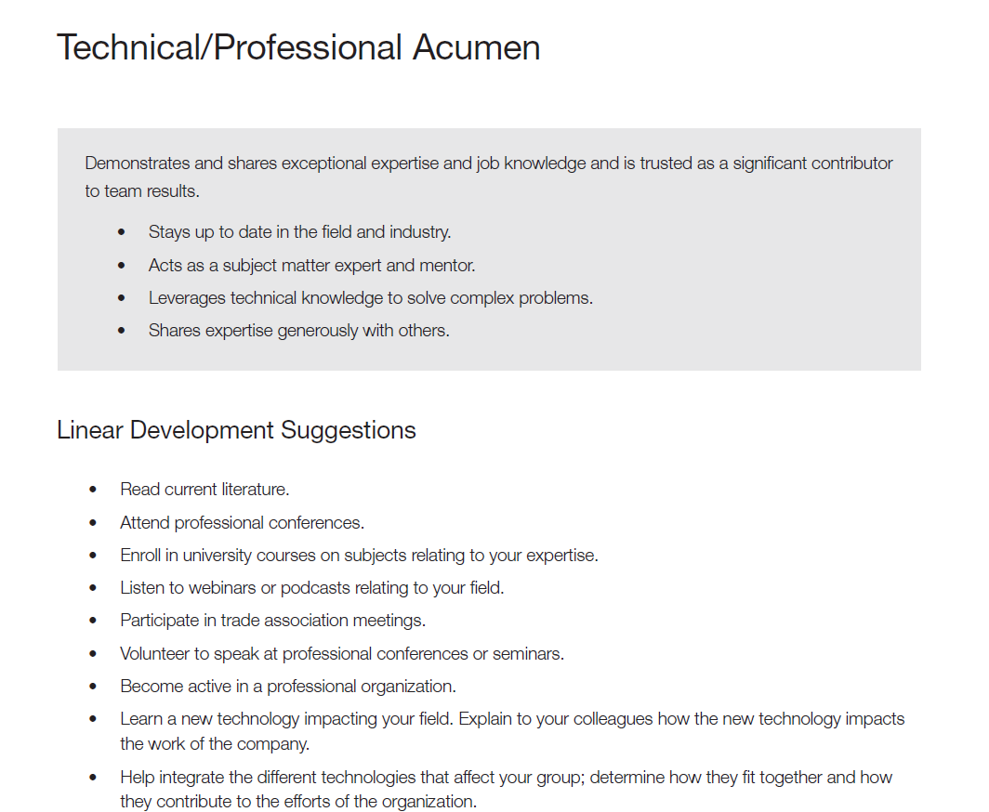
The Competency Companion Development Guide
We have created development guides on over 50 competencies.
Clients using a different 360-degree assessment can use our strength building insights.
Each competency is defined and has a list of Linear Developmental Suggestions.

Slide 35
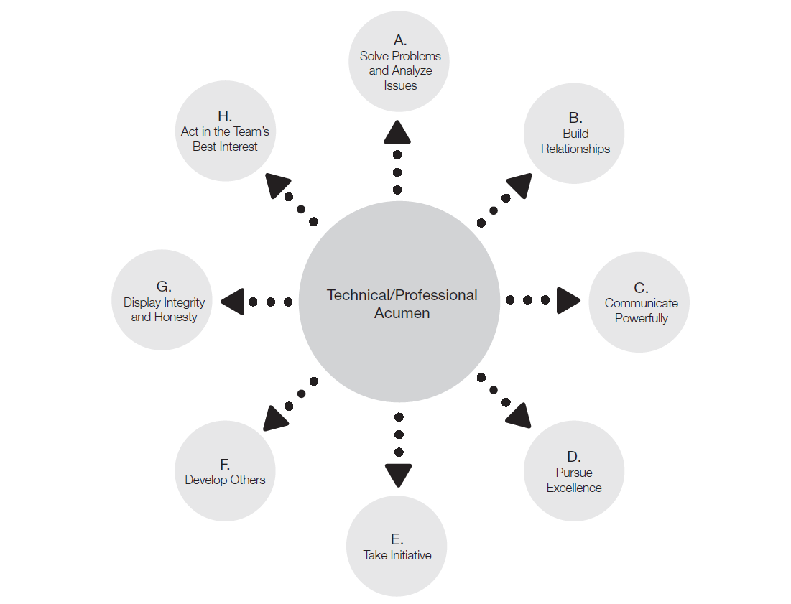
The Competency Companion Development Guide
Next the companion behaviors are displayed. Each competency has between 8 and 13 unique companion behaviors.

Slide 36
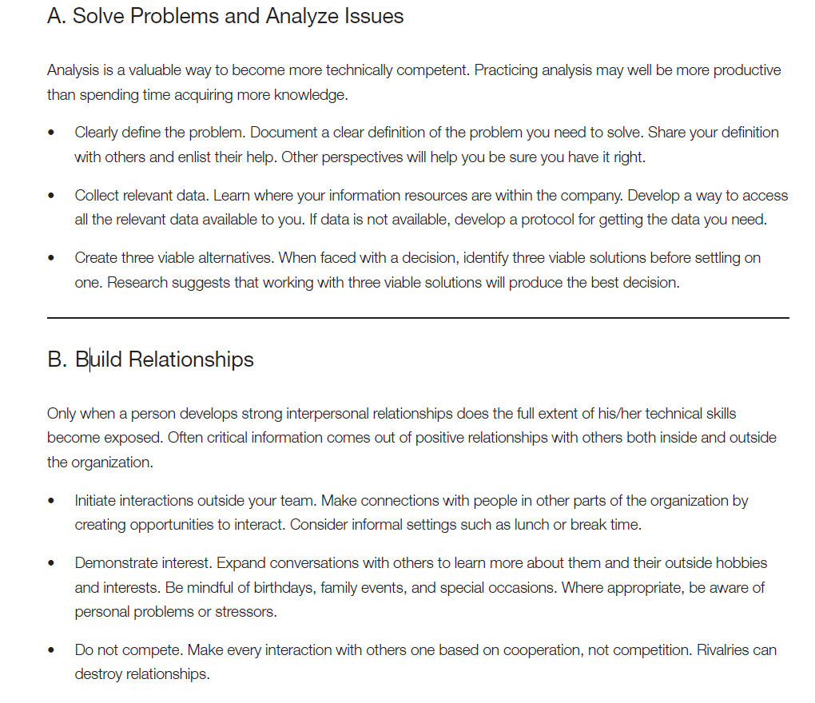
The Competency Companion Development Guide
For each companion behavior we provide a brief rationale of the connection between the companion behavior and the competency.
We also did provide three specific developmental suggestions that can be included in a development plan.

Slide 37
Results of the Strength Building Approach and Non- Linear Development
In a study of 4,216 leaders, 85% were able to make a significant positive improvement on one competency.

Slide 38

Next Steps
If you or your employees are still focused on fixing weaknesses, consider how you might incorporate a strength building approach. Experiment with using a competency companion development guide for your leadership development efforts.
The link to download the development guide is included in the survey at the end of this webinar.
You can take the survey by going to:
bit.ly/zfoct19

Slide 39

“Man often becomes what he believes himself to be. If I keep on saying to myself that I cannot do a certain thing, it is possible that I may end by really becoming incapable of doing it. On the contrary, if I have the belief that I can do it, I shall surely acquire the capacity to do it even if I may not have it at the beginning.”
—Mahatma Gandhi
Survey link — bit.ly/zfoct19

Slide 40

Thank you
Contact us: info@zengerfolkman.com or www.zengerfolkman.com
Survey link — bit.ly/zfoct19

